Slide 1
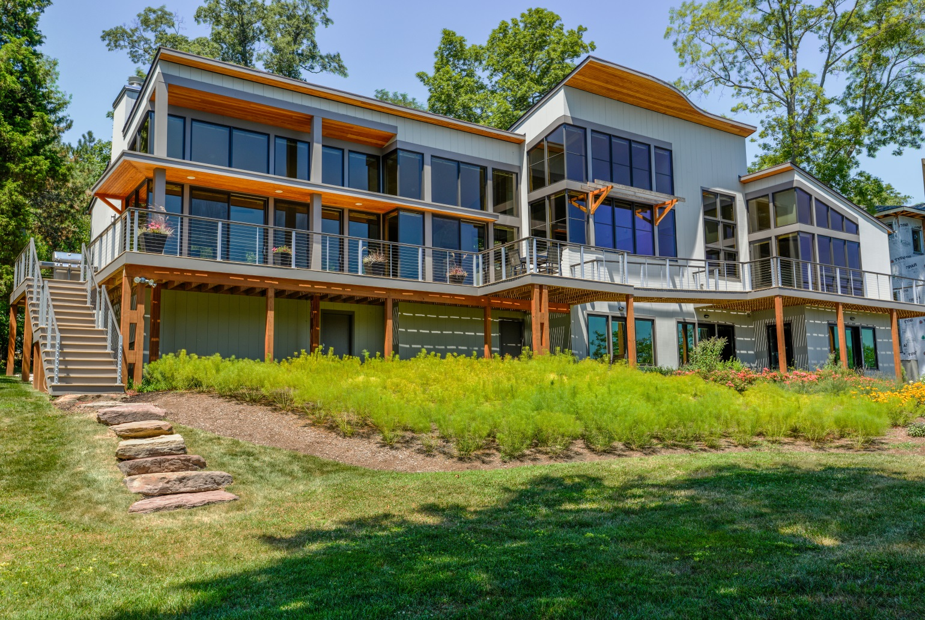
Project Name: The Wave House Location: South River, Maryland Category: Residence Description: The owners of this waterfront residence requested a home which would open to the sweeping views of the South River, creating a mural of the water, visible from all rooms. Audiophiles, their second request was to create a living area acoustically appropriate for listening to and playing classical music. As a result, the massing of the main living area was shaped as an amphitheater with a sloped shed roof gesturing upward towards the sky, a living area lowered a few steps and a flared floor plan which widens from the Living Room to the Dining Room and again at the Kitchen. Two-story columns break-free from the window wall to allow non-structural corners with butt-glazed windows and a continuous wrap around deck for more openness towards the view. Inspired by the serpentine form of sound and shoreline waves, curves were woven into the structure as a melody unifies a composition. The deep overhang on the south side was carved into a piano curve and cantilevered for added sun-shading. In the Entry, a free-standing single-width serpentine glass block wall, stabilized by the inherent shape of a wave, veils the view of the kitchen while letting in daylight and the reflection of the water beyond. A wrap-around deck on the waterside extends the living space to the outdoors. A portion of the deck was turned into a bridge, connecting the living room deck to the master bedroom deck, to allow daylight into the bedrooms on the lower level. The smooth skin of the exterior was achieved without using wood by routing composite boards, made by Boral, into vertical lap siding.

Slide 2
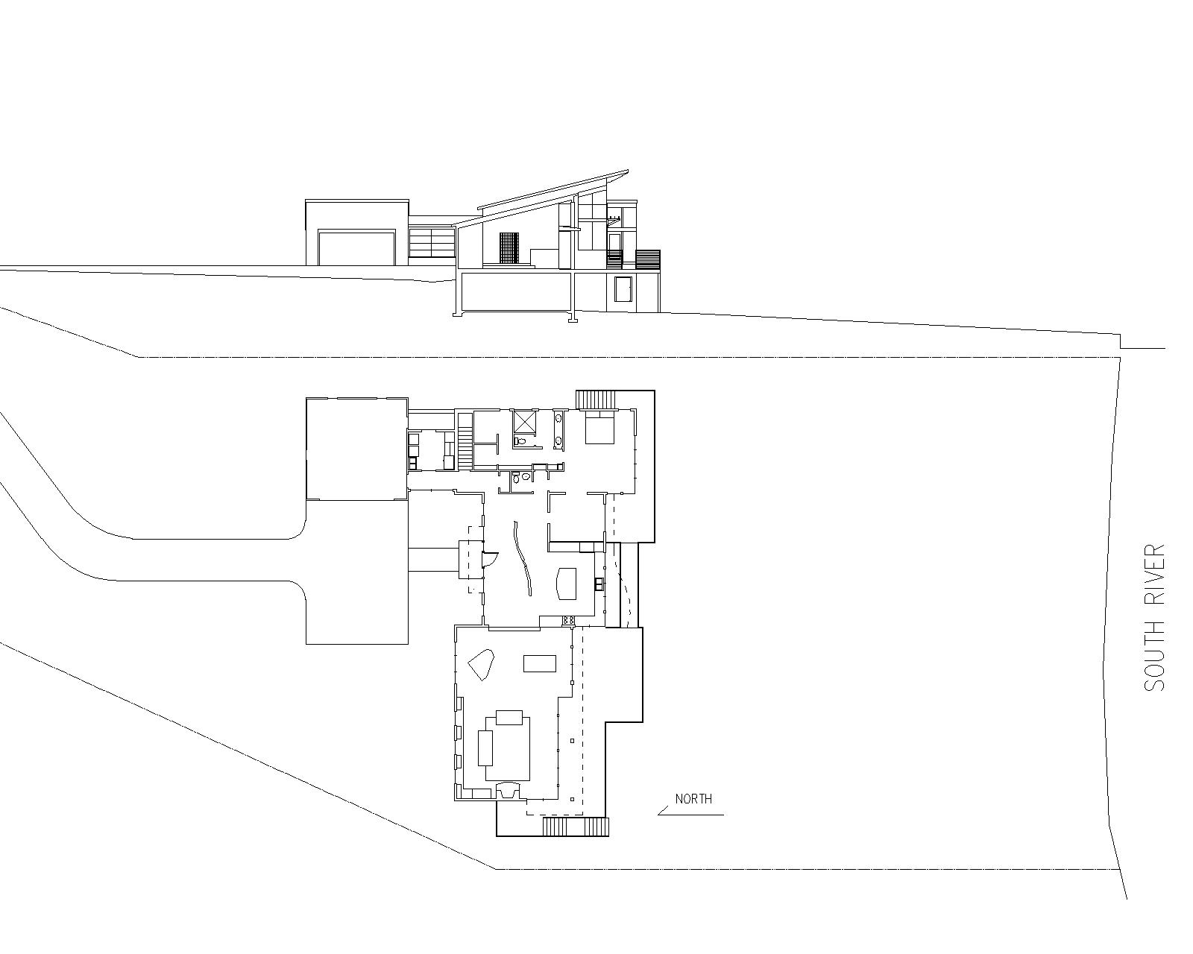

Slide 3
South & Waterside Elevation

Slide 4
Entry Courtyard

Slide 5
Entry Detail

Slide 6
Entry

Slide 7
Living & Dining Room

Slide 8
South Deck

Slide 9
Kitchen

Slide 10
Master Bedroom

